Slide 1
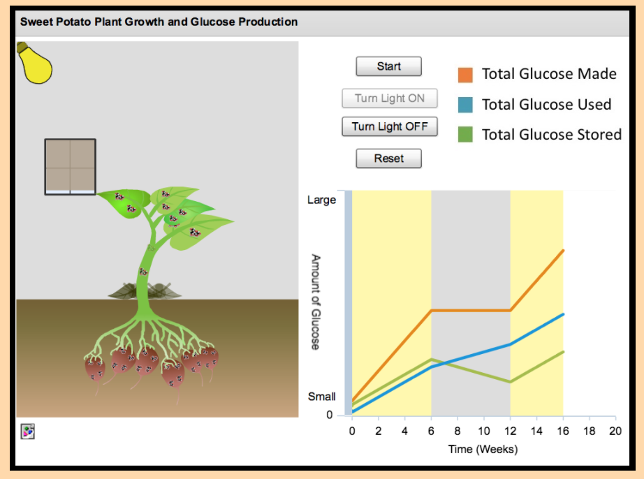




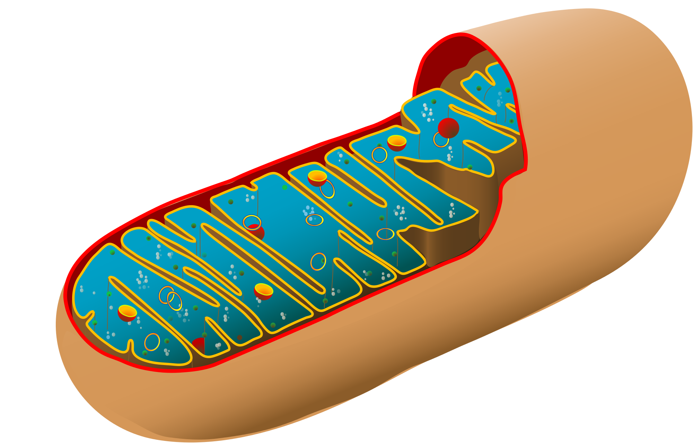
Light: on---off
Help (shows key)
?
slider
reset
Key
Play/pause
Total Glucose Made, Used, and Stored
Start State
Graph
Graph colors should match the organelles: Green-made, Orange-used, Blue-stored
Energy
Needs
3
Repair Damage
Transport Nutrients
Time (Days)

Slide 2
Light: on---off
Help (shows key)
?
slider
Play/pause
reset
Key
When 0, 1, or 2 glucose are in storage, leaf is yellow
Total Glucose Made, Used, and Stored
Graph
Energy
Needs
3
Repair Damage
Transport Nutrients
Time (Days)

Slide 3
Light: on---off
?
Light is on.
Day 1, time 1:
2 photons hit chloroplast
Key
Total Glucose Made, Used, and Stored
Graph
Energy
Needs
3
Repair Damage
Transport Nutrients
Time (Days)

Slide 4
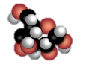
Light: on---off
?
Light is on.
Day 1, time 2:
2 glucose made in chloroplast
Key
Total Glucose Made, Used, and Stored
Batteries go down to yellow. “Energy needs” symbol changes
Graph
Energy
Needs
!
Repair Damage
Transport Nutrients
Time (Days)

Slide 5
Light: on---off
?
Light is on.
Day 1, time 3:
1 glucose stays in chlroplast one goes to mitochondrion
Key
Total Glucose Made, Used, and Stored
Graph
Energy
Needs
!
Repair Damage
Transport Nutrients
Time (Days)

Slide 6
Light: on---off
?
Light is on.
Day 1, time 4:
Glucose fades out
Key
Total Glucose Made, Used, and Stored
Graph
Energy
Needs
!
Repair Damage
Transport Nutrients
Time (Days)

Slide 7
Light: on---off
?
Light is on.
Day 1, time 5:
Batteries appear
Key
Total Glucose Made, Used, and Stored
Batteries empty
Graph
Energy
Needs
!
Repair Damage
Transport Nutrients
Time (Days)

Slide 8
Light: on---off
?
Light is on.
Day 1, time 6:
Batteries fill energy needs
Key
Total Glucose Made, Used, and Stored
Old batteries get pushed out and disappear
Graph
Energy
Needs
Repair Damage
Transport Nutrients
Time (Days)

Slide 9
Light: on---off
?
Light is on.
Day 1, time 7:
Remaining glucose goes to storage
Key
Total Glucose Made, Used, and Stored
Graph
Energy
Needs
3
Repair Damage
Transport Nutrients
Time (Days)

Slide 10

Light: on---off
?
Key
When 3, 4, or 5 glucose are in storage, leaf is light green
Total Glucose Made, Used, and Stored
Graph
Energy
Needs
3
Repair Damage
Transport Nutrients
Time (Days)

Slide 11

Light: on---off
?
Key
When 6 or more glucose are in storage, leaf is dark green
Total Glucose Made, Used, and Stored
Graph
Energy
Needs
3
Repair Damage
Transport Nutrients
Time (Days)

Slide 12

Light: on---off
?
Key
When light is off:
Day X, time 1:
1 glucose moves out of storage to mitochondrion.
Total Glucose Made, Used, and Stored
Batteries go down to yellow
Graph
Energy
Needs
!
Repair Damage
Transport Nutrients
Time (Days)

Slide 13
Light: on---off
?
Light is off.
Day X, time 2:
Glucose fades out
Key
Total Glucose Made, Used, and Stored
Graph
Energy
Needs
!
Repair Damage
Transport Nutrients
Time (Days)

Slide 14
Light: on---off
?
Light is off.
Day X, time 3:
Batteries appear
Key
Total Glucose Made, Used, and Stored
Batteries empty
Graph
Energy
Needs
!
Repair Damage
Transport Nutrients
Time (Days)

Slide 15
Light: on---off
?
Light is off.
Day X, time 4:
Batteries fill energy needs
Key
Total Glucose Made, Used, and Stored
Empty batteries get pushed out
Graph
Energy
Needs
!
Repair Damage
Transport Nutrients
Time (Days)

Slide 16
Light: on---off
?
Key
Total Glucose Made, Used, and Stored
If the student changes the state of the light in the middle of a cycle, the change does not take effect until the beginning of the next cycle. So if the light is off, and the vacuole has sent glucose to the mitochondria, and then the student turns the switch, the light does not actually get turned on until the empty batteries get pushed out and the cycle is ready to begin again. Because, if the light is hitting the chloroplast, we want it to make glucose, but we don’t want making and using and everything happening at the same time, that’s too much going on visually.
Graph
Energy
Needs
3
Repair Damage
Transport Nutrients
Time (Days)

Slide 17
Light: on---off
?
Key
When light is off, if there is no glucose in storage, the plant will die.
Total Glucose Made, Used, and Stored
Batteries go down to yellow and empty at the same rate as normal. If a battery is empty and there is no fresh one to replace it, the leaf dies and turns brown.
Graph
Energy
Needs
!
Repair Damage
Transport Nutrients
Time (Days)

Slide 18
0, 1, or 2 glucose in storage
3, 4, or 5 glucose in storage
6 or more glucose in storage
Dead

